Slide 1
DELE CA2 Task A
Joshua Yap

Slide 2
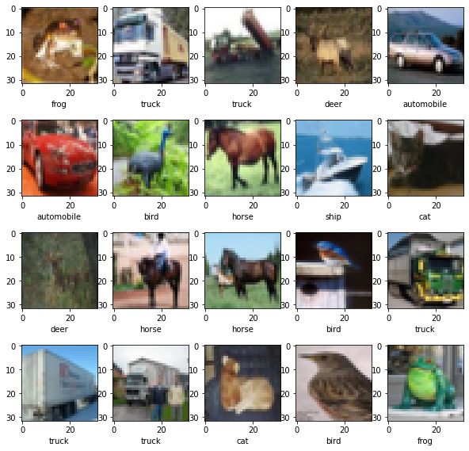
Data Viewing
Viewing of the data, shows various pictures of 10 classes.
They are "airplane", "automobile", "bird", "cat", "deer", "dog", "frog", "horse", "ship", "truck“
A base DCGAN on all classes will be used as a baseline
From there, experiments using fewer classes will be tested
Modified inputs will also be done
Finally, an alternate Gan structure will be compared to

Slide 3
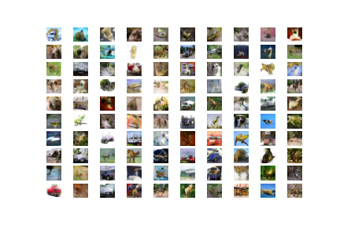
Base Gan
Base Gan will take in all 10 classes, and generate images.
Based on code by Jason Brownlee. After 150 epochs, the following output is returned
Images are quite blurry, but general shapes can be made out

Slide 4
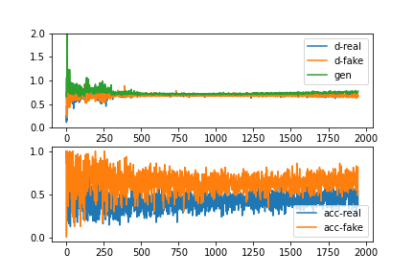
Evaluation
The loss for discriminator on fake and real images fluctuate greatly but hover around 0.5 as time goes on
The loss for the generator instead increases slightly
More epochs could increase the accuracy of images, but as the model currently has a wall time of over 1h, the trade-off in time is not worth possibly having more accurate images

Slide 5
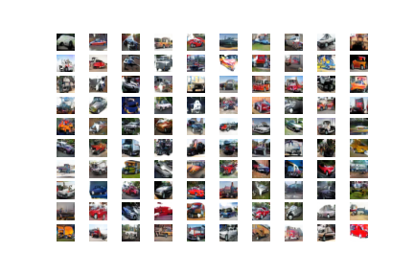
Gan on 2 classes
2 classes will be passed. The two chosen classes are “automobile” and “truck”. They were chosen as the images are quite similar.
The produced images resemble vehicles in general, with some images resembling more automobile or truck.
The model visually seems to produce accurate images

Slide 6
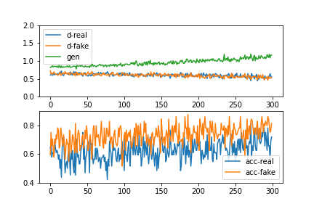
Evaluation
The model seems to be able to discriminate between real and fake images.
The loss, like previously, hovers around 0.5 for the discriminator. However, also shows some reduction and starts to diverge from the generator loss
However, the loss for the generator is starting to increase. In this case, more epochs could help to make the model produce more accurate images

Slide 7
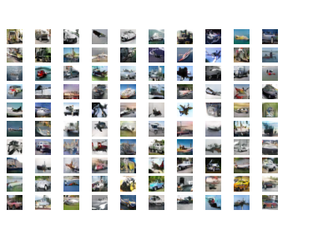
DCGan on 4 classes
This time, classes relating to “vehicles” were chosen. This experiment aims to see if having fewer classes will produce accurate images.
Some classes, like “automobile” and “truck” are quite similar, but it may not be the case for “automobile” and “ships”
So the test here is also to see if this difference will produce less accurate results
The model seems to produce images that resemble only one class more than the previous model
The images also seem to vary in quality like previously, some resembling a class more than others, and a few resembling a mix of two classes

Slide 8
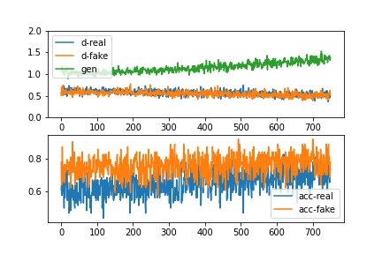
Evaluation
The loss for discriminator hovers around 0.5. the loss for generator seems to be increasing.
The loss for Gan, like previous models, seems to be increasing.
Accuracy for both real and fake is fluctuating but mostly remaining constant

Slide 9
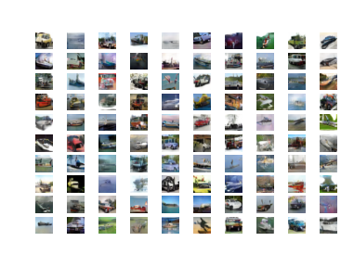
Sharpened Input on 4 Classes
The DCGAN built previously will be used with sharpened images.
A for loop was constructed to sharpen each image
Produces decently accurate images
Images seem to be of higher quality

Slide 10
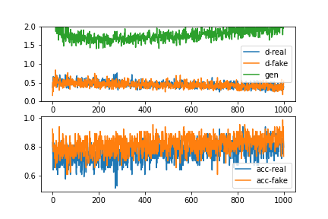
Evaluation
This time, 200 epochs were run
The generator loss is steadily increasing, but the accuracy of the discriminator on real and fake is starting to converge
It may not be worth adding more epochs as the time needed may not translate into clearer images
Furthermore, it seems that using sharpened images along with increased epochs produces clearer images

Slide 11
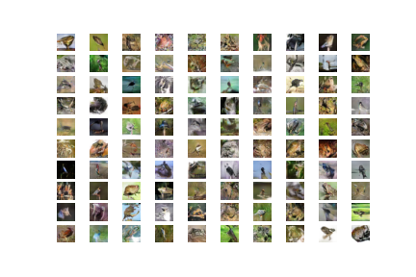
2 Class DCGAN with Different Classes
Two distinct classes, Frog and Bird, will be used to create a 2 class DCGAN to see if substantially different images will produce results that do not resemble the base classes
It seems that the images produced are quite similar to the “frog” class, with some resembling the “bird” class

Slide 12
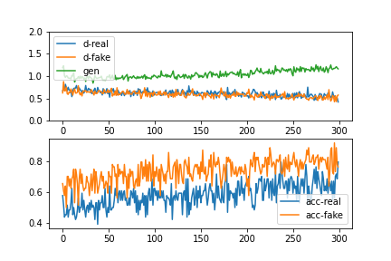
Evaluation
The loss for the generator this time seems to be approaching the loss of the discriminator.
Compared to previous models, this may not be ideal as the images produced here is not the best
On the other hand, the plot does not show any obvious mode collapse
Thus, the model here is considered to have produced poor quality images

Slide 13
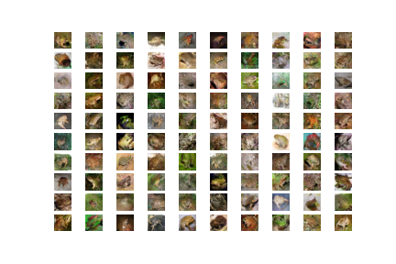
Frog class with modified input
With sharpened images, 200 epochs, the resultant images resemble frogs decently well
Compared to doing 2 classes of frog and bird, this may be preferred as the images generated using 2 classes do not resemble either class well

Slide 14
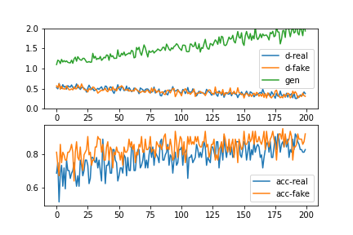
Frog class with modified input
The test is to see if a DCGAN is effective at producing one class only, thus replacing a Conditional GAN by making 10 DCGAN, one for each class
The gen loss is diverging from discriminator loss
While accuracy for real and fake fluctuates wildly but shows some convergence

Slide 15
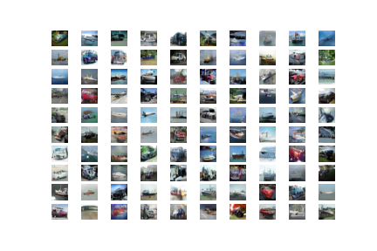
Modified DCGAN
Shown here is a modified DCGAN with a discriminator with double the number of Conv2D and LeakyReLu layers.
It also accepted sharpened images and underwent 200 epochs
Compared to the standard model, it produces lower quality images in a shorter amount of time

Slide 16
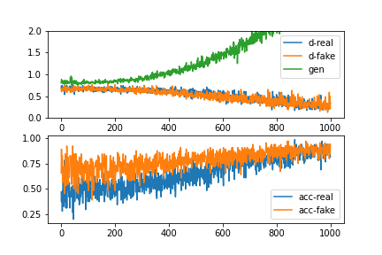
Evaluation
The generator loss has diverged far from the loss of the discriminator loss
Convergence of the accuracy has been reached
Thus, although it has good quality, it may not be considered to be a model to be used to generate images of the 4 classes

Slide 17
Conclusions
DCGan is a good all rounder Gan for image generation
To improve it, consider increasing the epochs and decreasing the number of classes that differ greatly from each other.

Slide 18
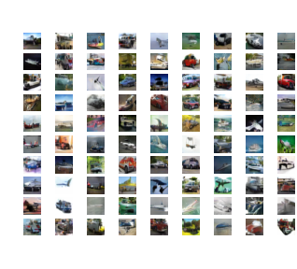
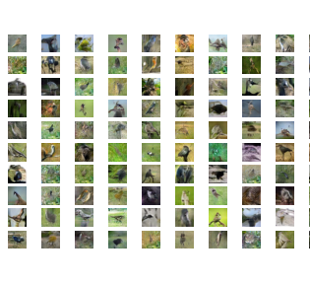
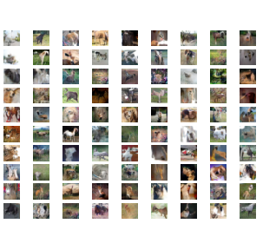
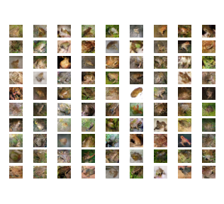
Generated Images

Slide 19
References
https://github.com/mvedang/Conditional-GAN-CIFAR-10/blob/master/cgan.ipynb
https://machinelearningmastery.com/how-to-develop-a-generative-adversarial-network-for-a-cifar-10-small-object-photographs-from-scratch/

Slide 20

End

